Slide 1
Aug-Sep Presentation Report
18/09/23

Slide 2
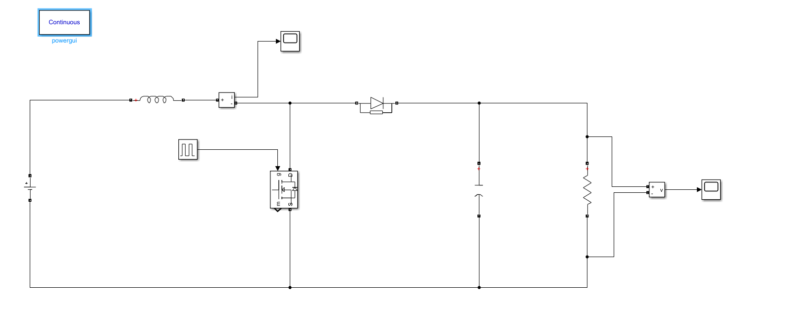
Boost Converter Simulink Model
Input Voltage - 12V
Output Voltage - 20V
Switching Frequency - 25 kHz
Power - 100W
Ripple in Output Voltage - 1%
Ripple in Inductor Current - 30%
Efficiency - 100%
Inductance - 76.8e-6
Capacitance - 400e-6
Resistance - 4
Pulse Generator:
Amplitude: 1
Period: 40e-6
Pulse width: 40%

Slide 3
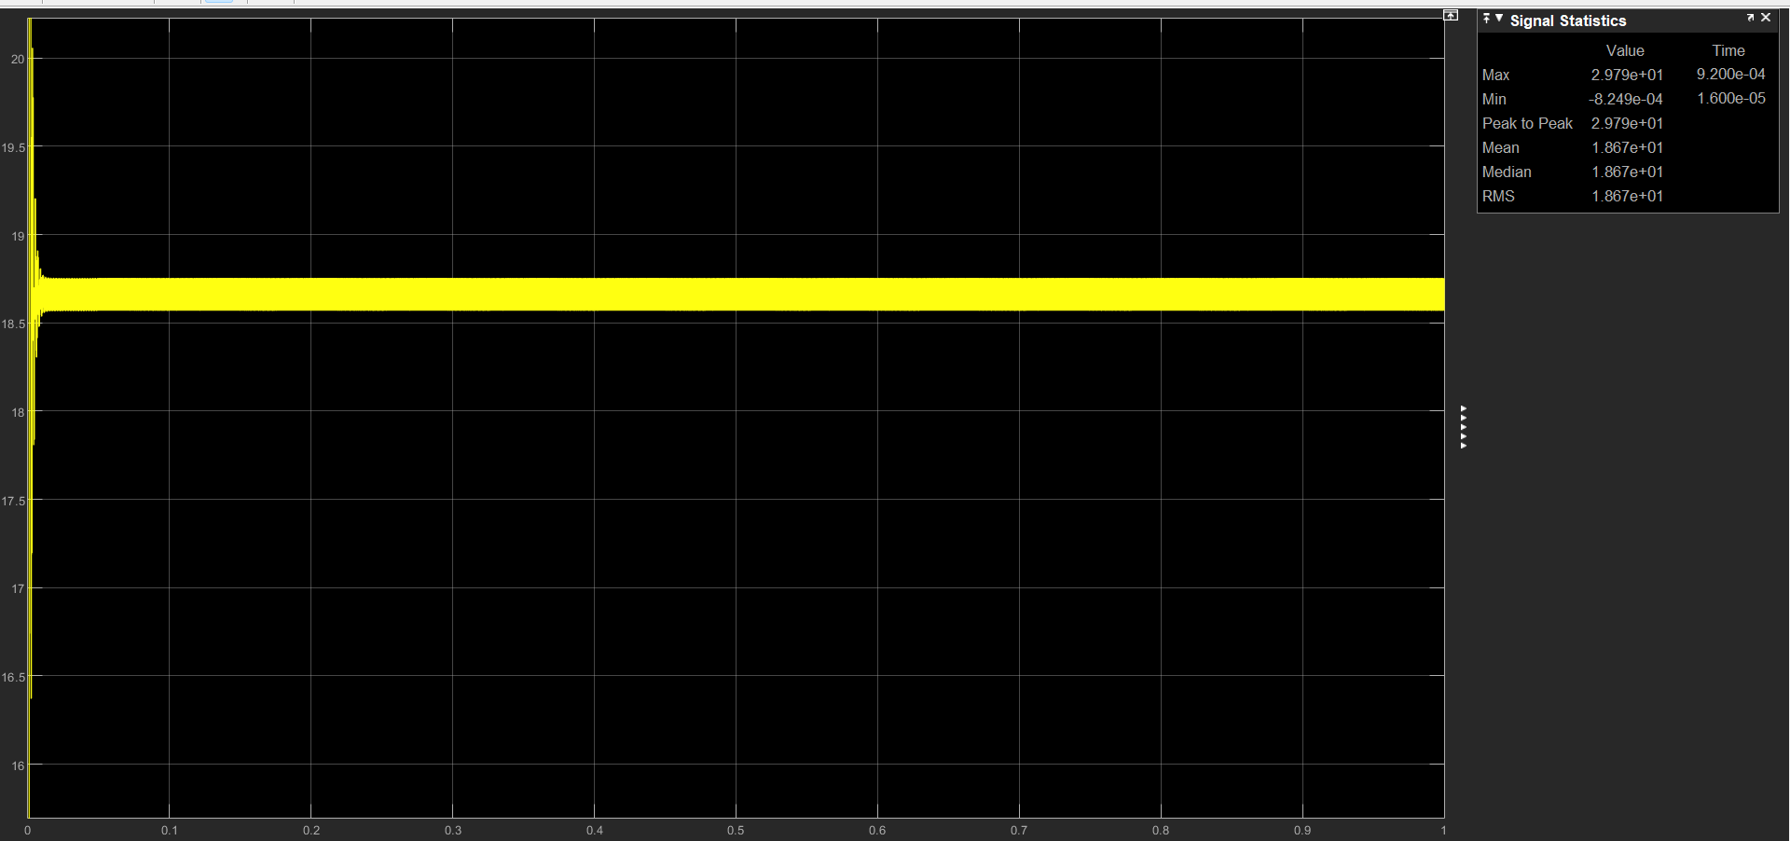
Output

Slide 4
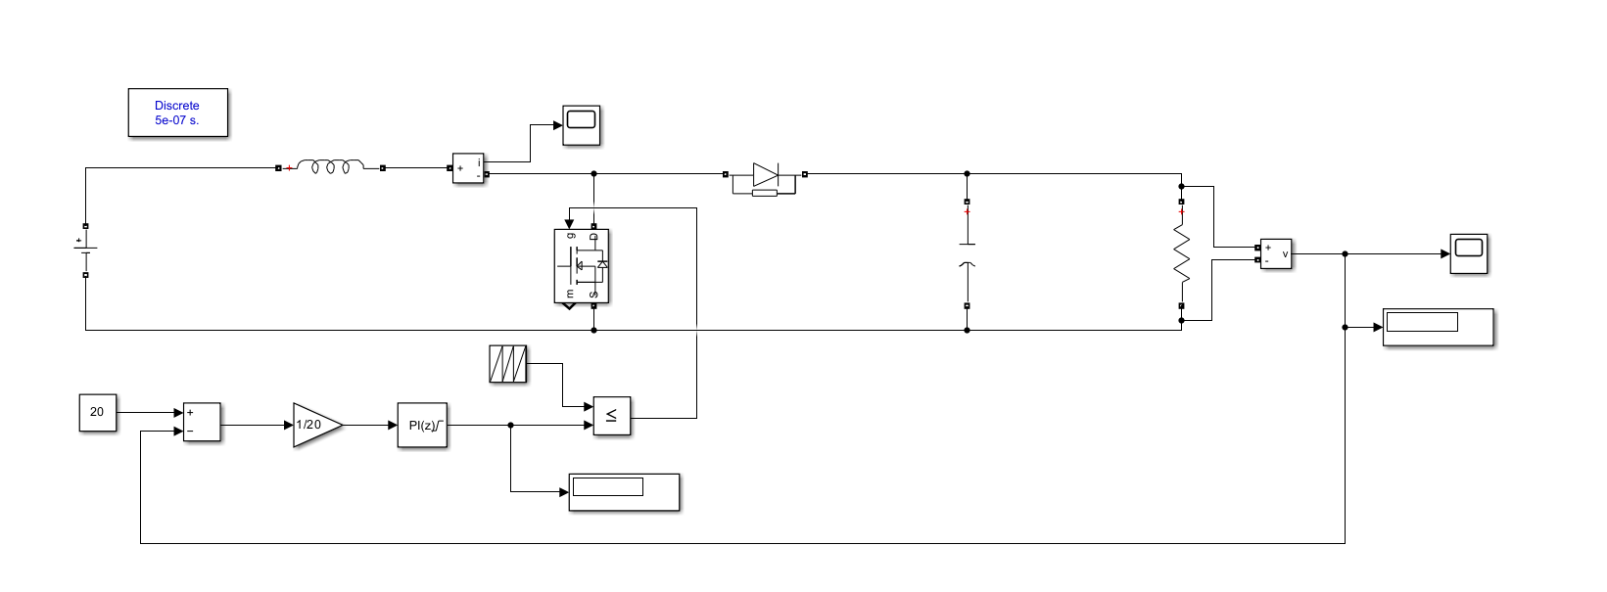
Closed loop boost converter using PI Controller
P = 0.7
I = 100
Repeating sequence time period: 4e-5
Same parameters as open loop boost converter

Slide 5
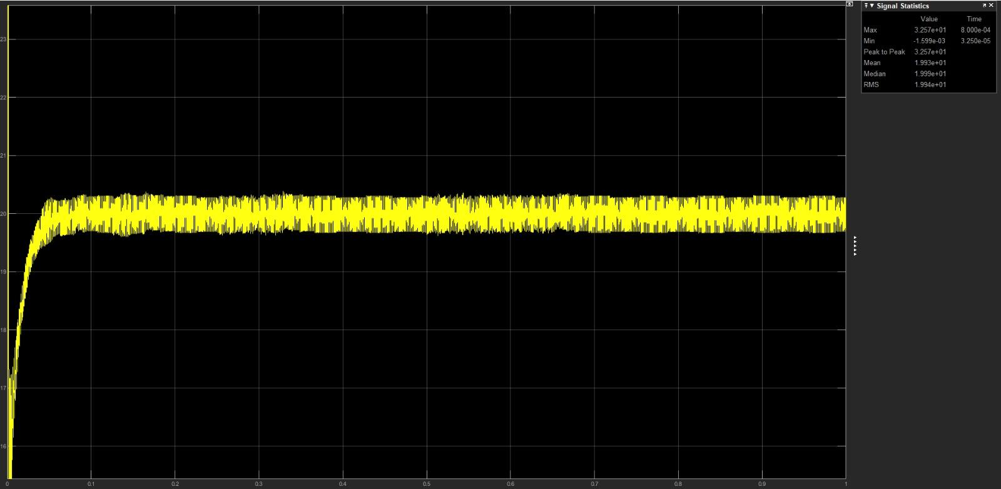
Output

Slide 6
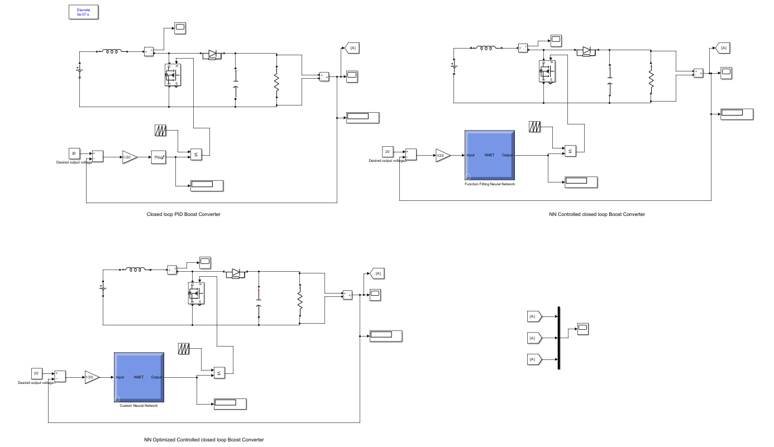
PI vs NN vs NN Optimized models

Slide 7
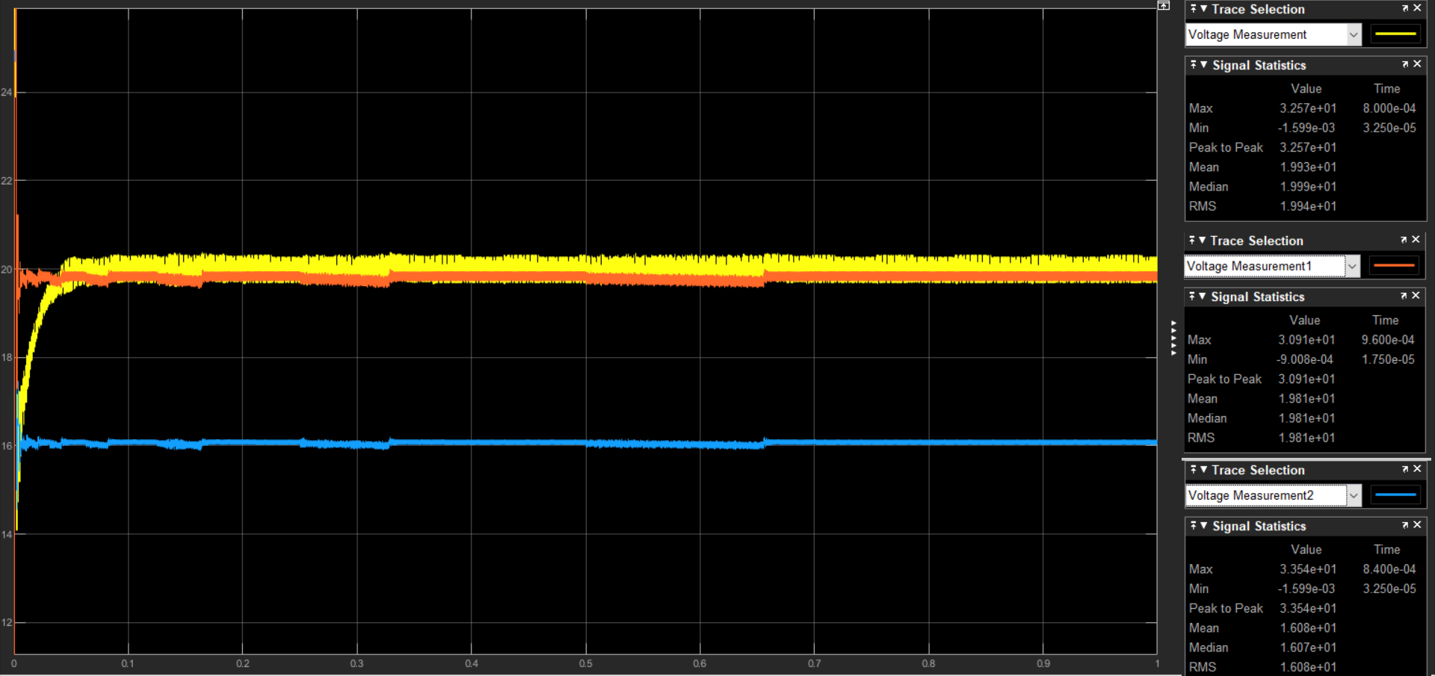
Output

Slide 8
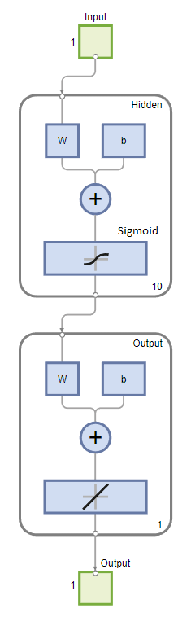
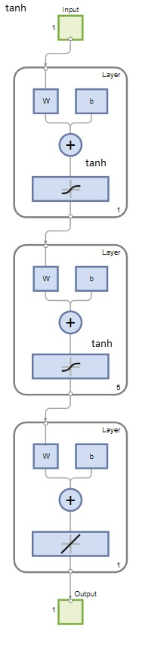
Changes Implemented:
Increase in number of hidden layers.
Activation functions changed from sigmoid to tanh.
Hyperparameters adjusted and added. momentum for faster convergence.
Further improvements to be made:
Regularization and augmentation techniques to combat overfitting.
Expanding the dataset to fit values other than just target of 20V.
Signal processing techniques to deal with the initial noise in values.
Convert activation functions to ReLU for faster convergence.
NN simple
NN Optimized

Slide 9
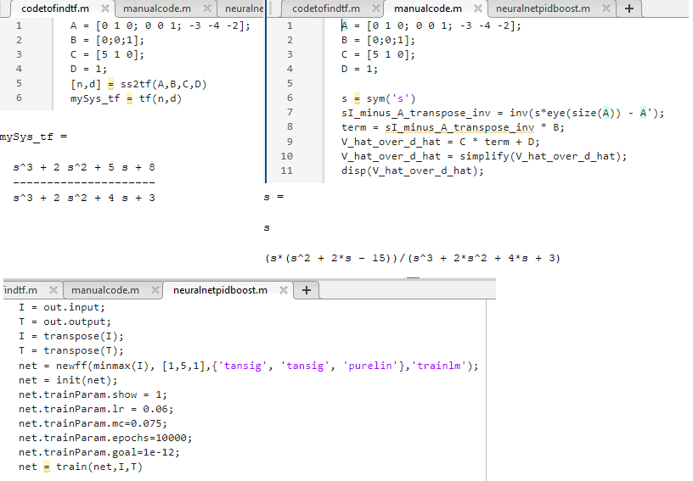
Some Important programs implemented:

